Slide 1
OOAD PRESENTATION
SPACE MANAGEMENT SYSTEM

Slide 2
SPACE MANAGEMENT SYSTEM
Visitors enters the parking section and receives the token from the accountant who is present at the entrance. The parking slot which is free is assigned for the visitor and the details are updated by the parking system. The faculty can request the manager for a permanent parking slot. The manager assigns a parking slot for the faculty. The faculty or the student can book for hall or flex board. Events that are happening in the college are conducted in different halls based on the requirements. The student sends request for hall or flex to the manager. The manager allocates free halls/flex for the requested faculty. The student has to get a permission letter /confirmation letter from the faculty in-charge of the event for booking the hall. Once the permission is got the manager allocates hall/flex for the student/faculty.

Slide 3
TOP DOWN APPROACH
Visitors
parking section
Token
Accountant
entrance (irrelevant)
parking slot
Details(irrelevant)
Faculty
Manager
Student
Hall
Flex board
Events
Permission letter
Login(attribute)
Password(attribute)
Reply(attribute)
Tutor(role)

Slide 4
BOTTOM UP APPROACH
Visitors
parking section
Token
Accountant
parking slot
Faculty
Manager
Student
Hall
Flex board
Events
Bill (redundancy)
Permission/confirmation(irrelevant)
Amount(attribute)

Slide 5
SEQUENCE APPROACH
Entry session
Visitor
Accountant
Cars
Token
Exit_session
Amount
Faculty
Request_msg
Manager
Student
Details (vague)
Confirmation(irrelevant)
Flex
Hall
events

Slide 6
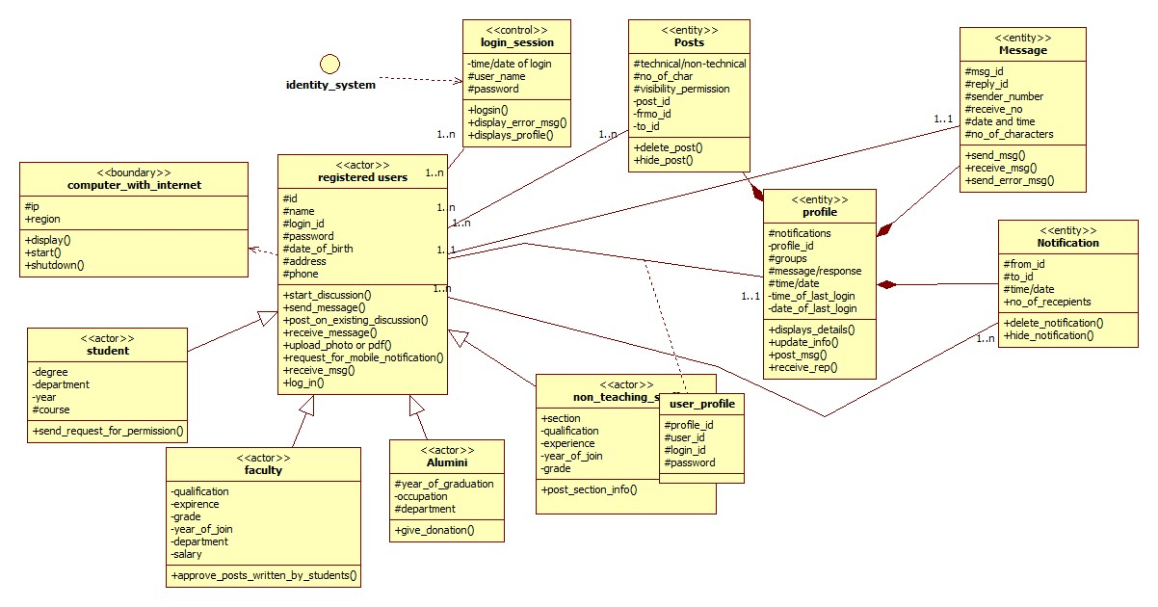

Slide 7
NETWORK OF TECHIANS
This system is used as a way of instant communication among techians from anywhere. All techians will be provided with a unique login id at the time of admission in the “tech.com” domain based on their departments. Students,faculty,non-teaching staff,alumni logs into their account and they have a profile describing all the details about them. Student can start a discussion in the forum either technical/nontechnical.Posts written by students will checked by the authorized tutor before publishing it on the website.Faculty can post any information regarding the events or any technical issues . Student,faculty can send messages to each other and communicate with each other. The notifications are shown in the profile of the registered member. Alumni can also post or send messages to other registered members.The login authentication will be managed by the identity management system. The system provides instant notification on mobile if subscribed.

Slide 8
TOP DOWN APPROACH
faculty
student
non_teaching
alumni
message
post
profile
identity_system
login(attri)
password(attri)
reply(attribute)
tutor(role)

Slide 9
BOTTOM UP APPROACH
Student
Faculty
Non_teaching staffs
Alumni
Registered_user
Login(attribute)
Request_msg
Comments (redundancy)
Notification
Confirmation(redundancy)

Slide 10
SEQUENCE APPROACH
Registered_user
Alumni
Student
faculty
identity system
message
post
tutor
notifications
msg_system
Donation (attribute)

Slide 11
